Slide 1

Municipal Fund Allocations And Project Progress System
From: SR UNIVERSITY Team Name : United
Welcome to our presentation on the Municipal Fund Allocations and project progress
System. we will introduce our innovative project.

Slide 2
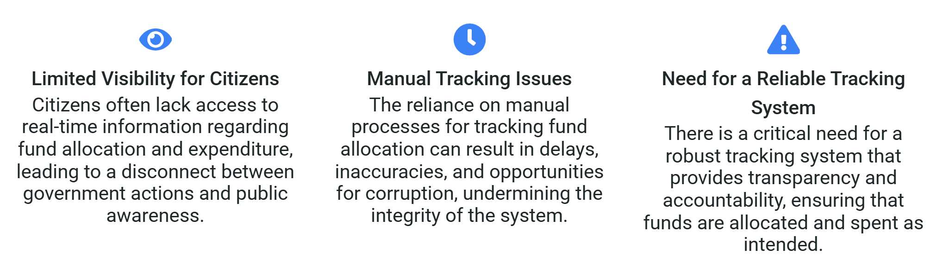
Problem Statement
We identified a major issue — the lack of transparency in how municipal funds are allocated and used . This often leads to inefficiency, mismanagement, and loss of public trust. When citizens can’t see where money goes, they start losing confidence in local governance.

Slide 3
Proposed Solution
Block Chain:
Need for a Reliable Tracking System
Limited Visibility for Citizens
Manual Tracking Issues
Launch a public, mobile-friendly transparency portal backed by blockchain so residents can see live allocations and spending per project. Each line item shows budget vs. spent, milestone status, and verifiable proofs (IPFS receipts + transaction hash), with simple summaries, multilingual support, and optional email/SMS alerts.
Deploy an end-to-end accountability stack: smart contracts enforce budget caps and rules, documents are stored on IPFS with hashes on-chain, and every transaction is additionally anchored cross-chain for immutability. A real-time audit log and periodic Merkle snapshots provide tamper-evident oversight at city and state levels.
Replace spreadsheets and paper with a role-based e-workflow that records every action (create, approve, disburse, verify) as on-chain events. Field officers capture geo-tagged evidence, invoices are auto-reconciled against approvals, and smart validations prevent errors, cutting delays and tampering.
Right now, tracking municipal funds is slow and error-prone. Manual processes cause delays, misuse, and even corruption, while lack of proper training leads to mistakes. Political influence can also skew decisions. This reduces citizen trust and makes resource tracking very difficult.

Slide 4
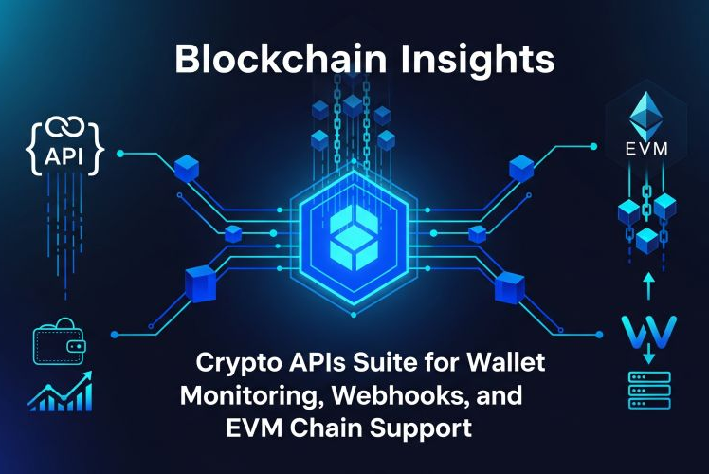
Challenges in Fund Allocation
Introduction to the Blockchain Solution
Blockchain technology offers a decentralized and secure method for tracking municipal funds, ensuring that all transactions are recorded in an immutable ledger accessible to all stakeholders.
Real-Time Monitoring via Public Dashboard
A public dashboard provides citizens with real-time insights into fund allocation and expenditure, fostering transparency
Immutable Records from Allocation to Expenditure
The use of blockchain ensures that all records related to fund allocation and expenditure are tamper-proof, providing a reliable audit trail that enhances accountability.

Slide 5
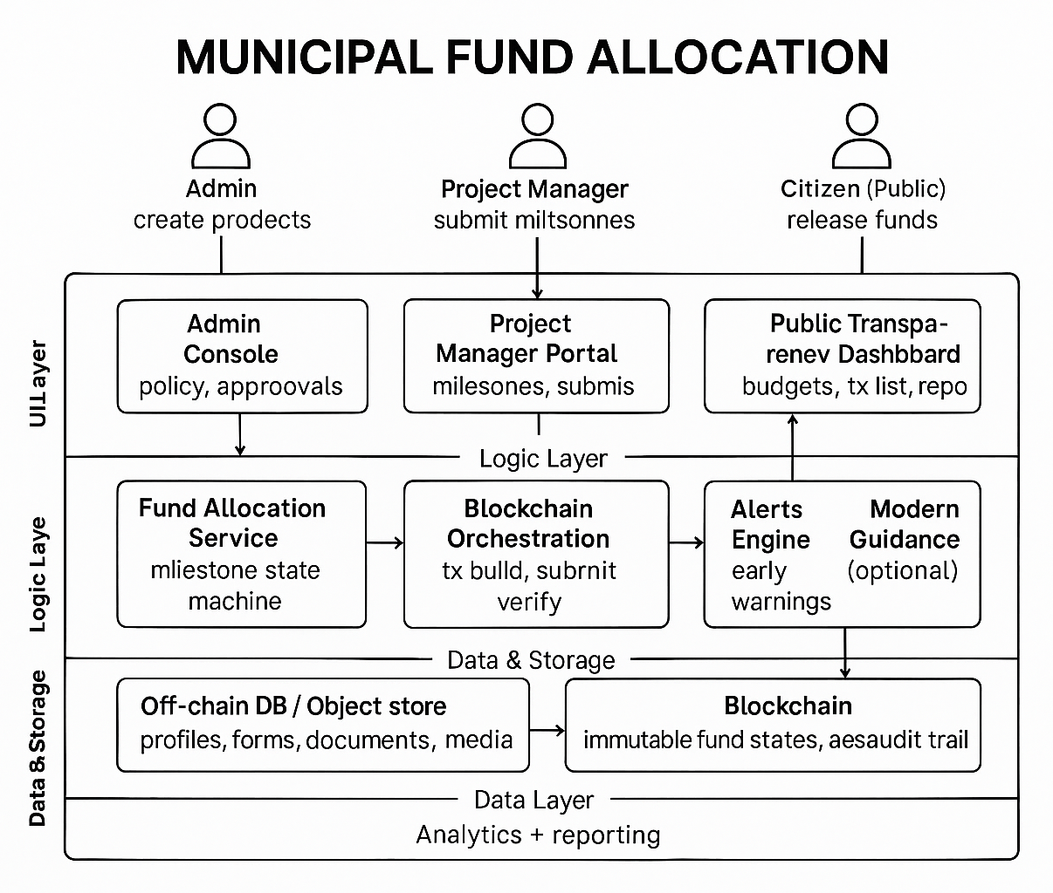
System Architecture (LLD Block Diagram)
Overview of the System Components
App & Dashboard – Input, monitor, reports
IoT & AI – Data collection, project analytics
Alerts Engine – Early alerts, notifications
Recommendations – Smart insights, fund optimization
Database – Project profiles, fund data
Blockchain – Secure and immutable records
Ayurvedic

Slide 6
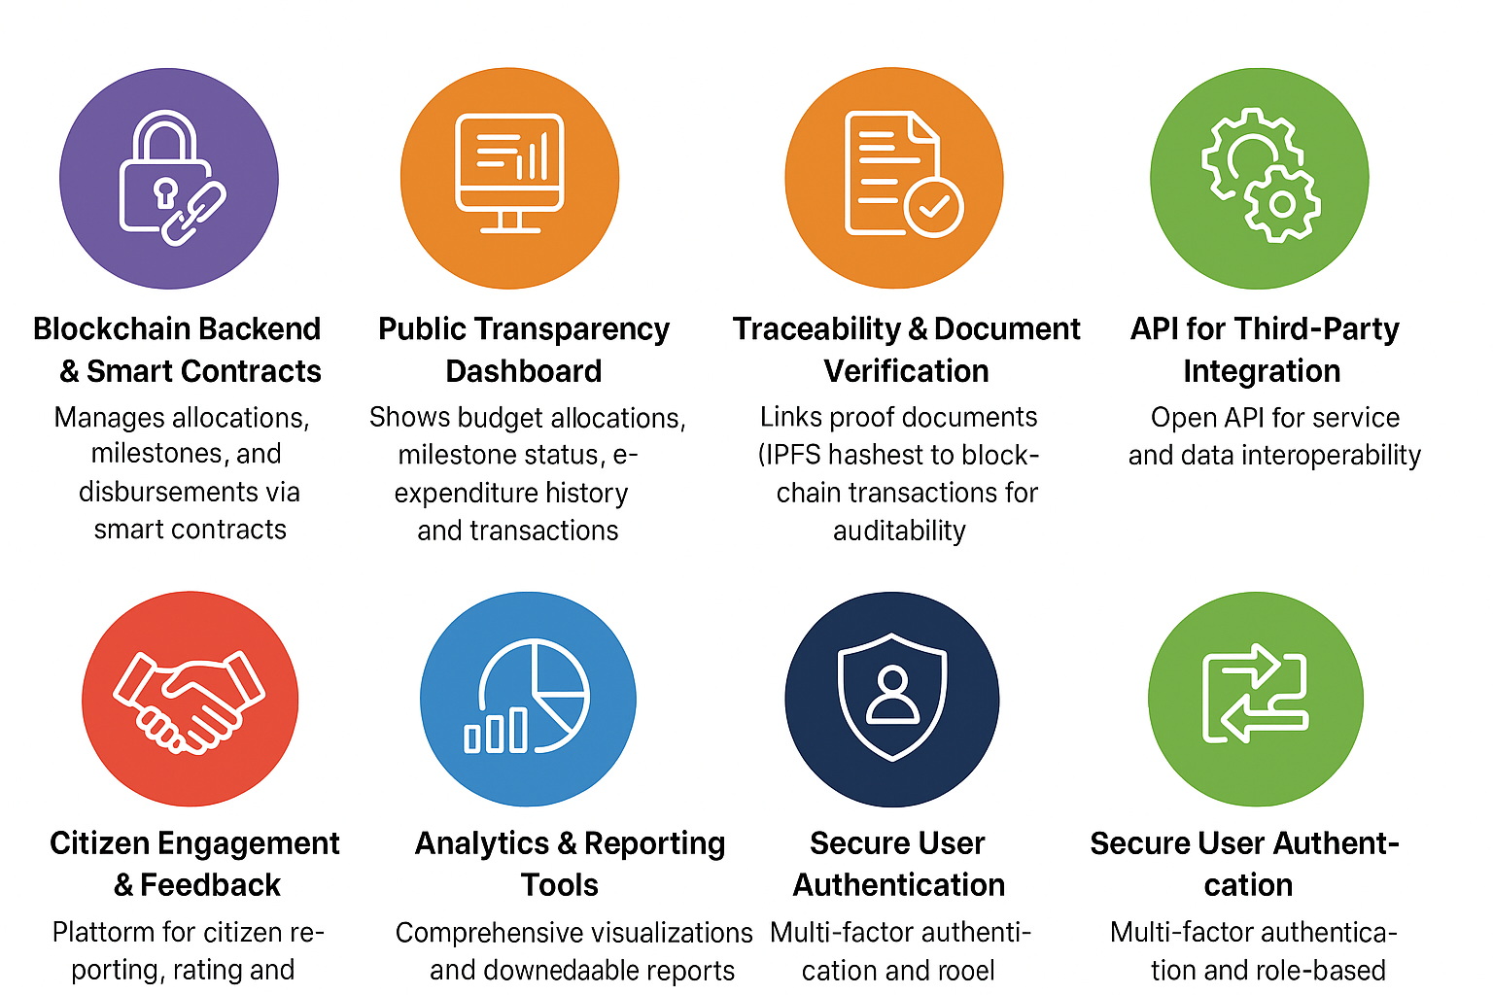
Key Features
Innovative Functionalities of the System
AI-powered prediction, IoT integration, preventive alerts, and personalized wellness plans. Dual recommendations (Ayurveda + modern medicine), doctor-patient dashboard, and knowledge graph support.

Slide 7
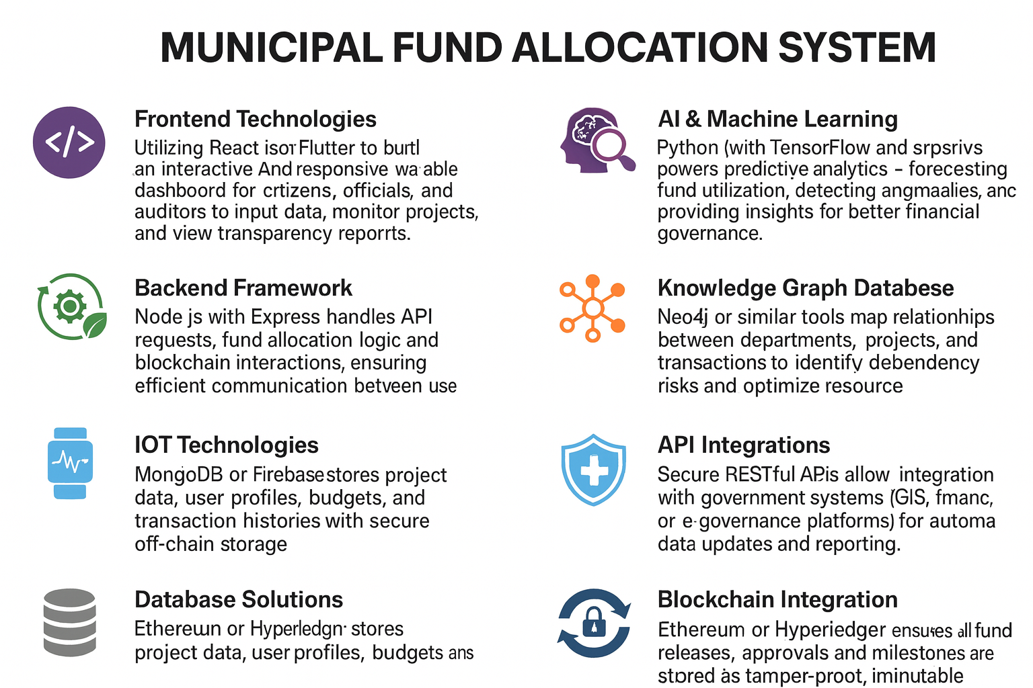
Tech Stack
Technological Framework Supporting the System
Our system utilizes a diverse technological stack including HTML, java,Node.js, Python, React Native, MongoDB/Firebase, Neo4j, and Blockchain for a secure and efficient he.

Slide 8


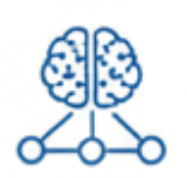

Data Flow Diagram (LLD)
Understanding the Flow of Information
Data Sources: The diagram illustrates various data sources, including municipal budgets, expenditure
reports, and community feedback mechanisms, which feed into the block
chain system, ensuring comprehensive data capture
Blockchain Processing: This section of the diagram highlights the core blockchain processing
unit, where data securely recorded, validated, and made immutable, ensuring
transparency and trust in fund allocation.
User Interfaces: The diagram showcases the different User interfaces available for stakeholders, including
dashboards for municipal officials and mobile applications for citizens, facilitating real time access to fund tracking information.
Feedback Loop: A feedback loop is depicted, demonstrating how user interactions and community
feedback are integrated back into the system, allowing for continuous improvement and
responsiveness to citizen needs.
The diagram shows how municipal data flows through blockchain for secure recording, transparency, user dashboards, and feedback-driven continuous improvement.

Slide 9

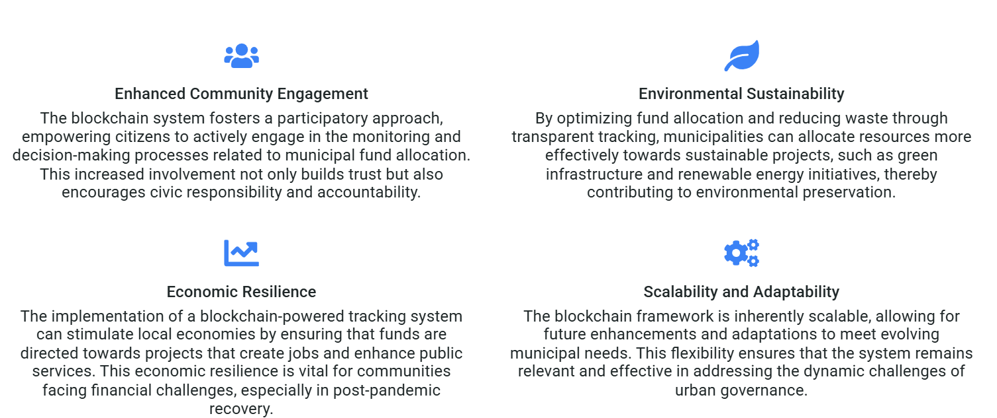
Impact & Sustainability
Long-Term Benefits of the System
“Our blockchain system empowers citizens to monitor funds, boosting transparency and accountability. It helps municipalities allocate resources efficiently, support sustainable projects, and strengthen local economies. Plus, it’s scalable and adaptable, ensuring long-term impact and relevance for future urban challenges.”

Slide 10

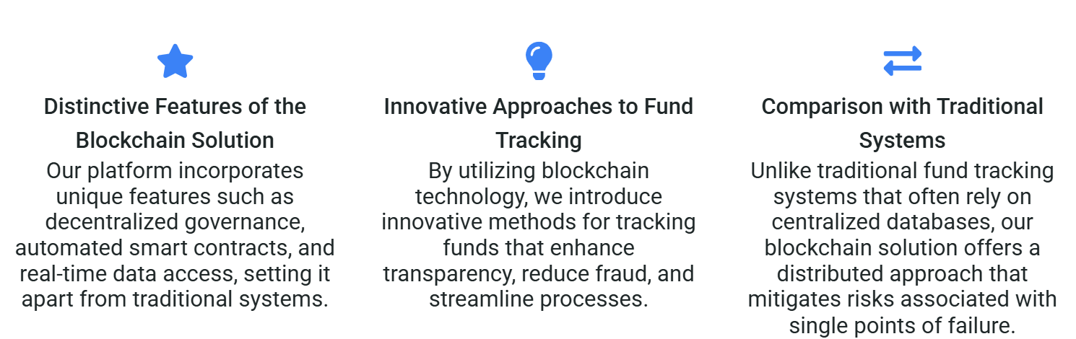
Uniqueness & Innovation
Distinctive Aspects of Our Approach
“Currently, municipal fund tracking is manual and inefficient, leading to errors, delays, and mismanagement. Citizens can’t see how funds are used, which reduces trust. We need a transparent, automated system to ensure accountability and clarity.”

Slide 11
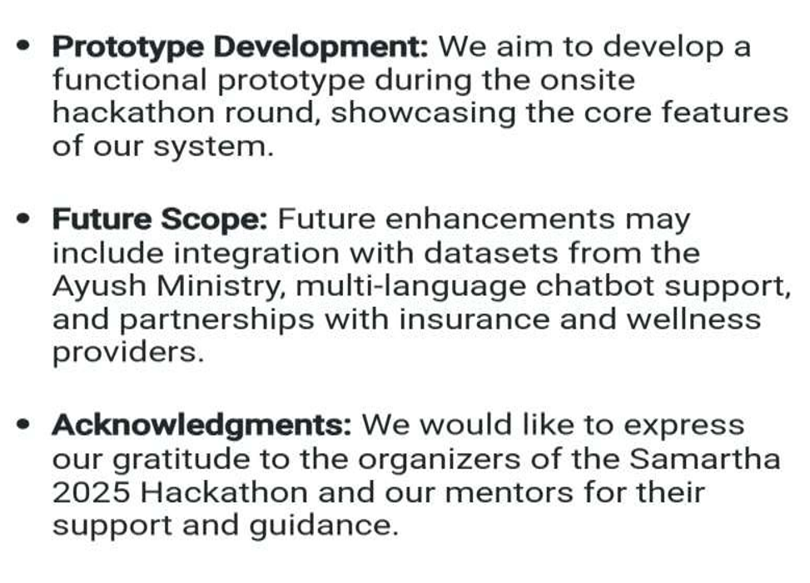
Conclusion & Next Steps
Future Directions and Acknowledgments
Thank you
Team Name : United team Members:
1. K. Nithin Kumar
2. G. Harshitha
3. J. vyshnavi
4. B. Shiva Sai
5. D. Aakarsh
From SR University

